Slide 1
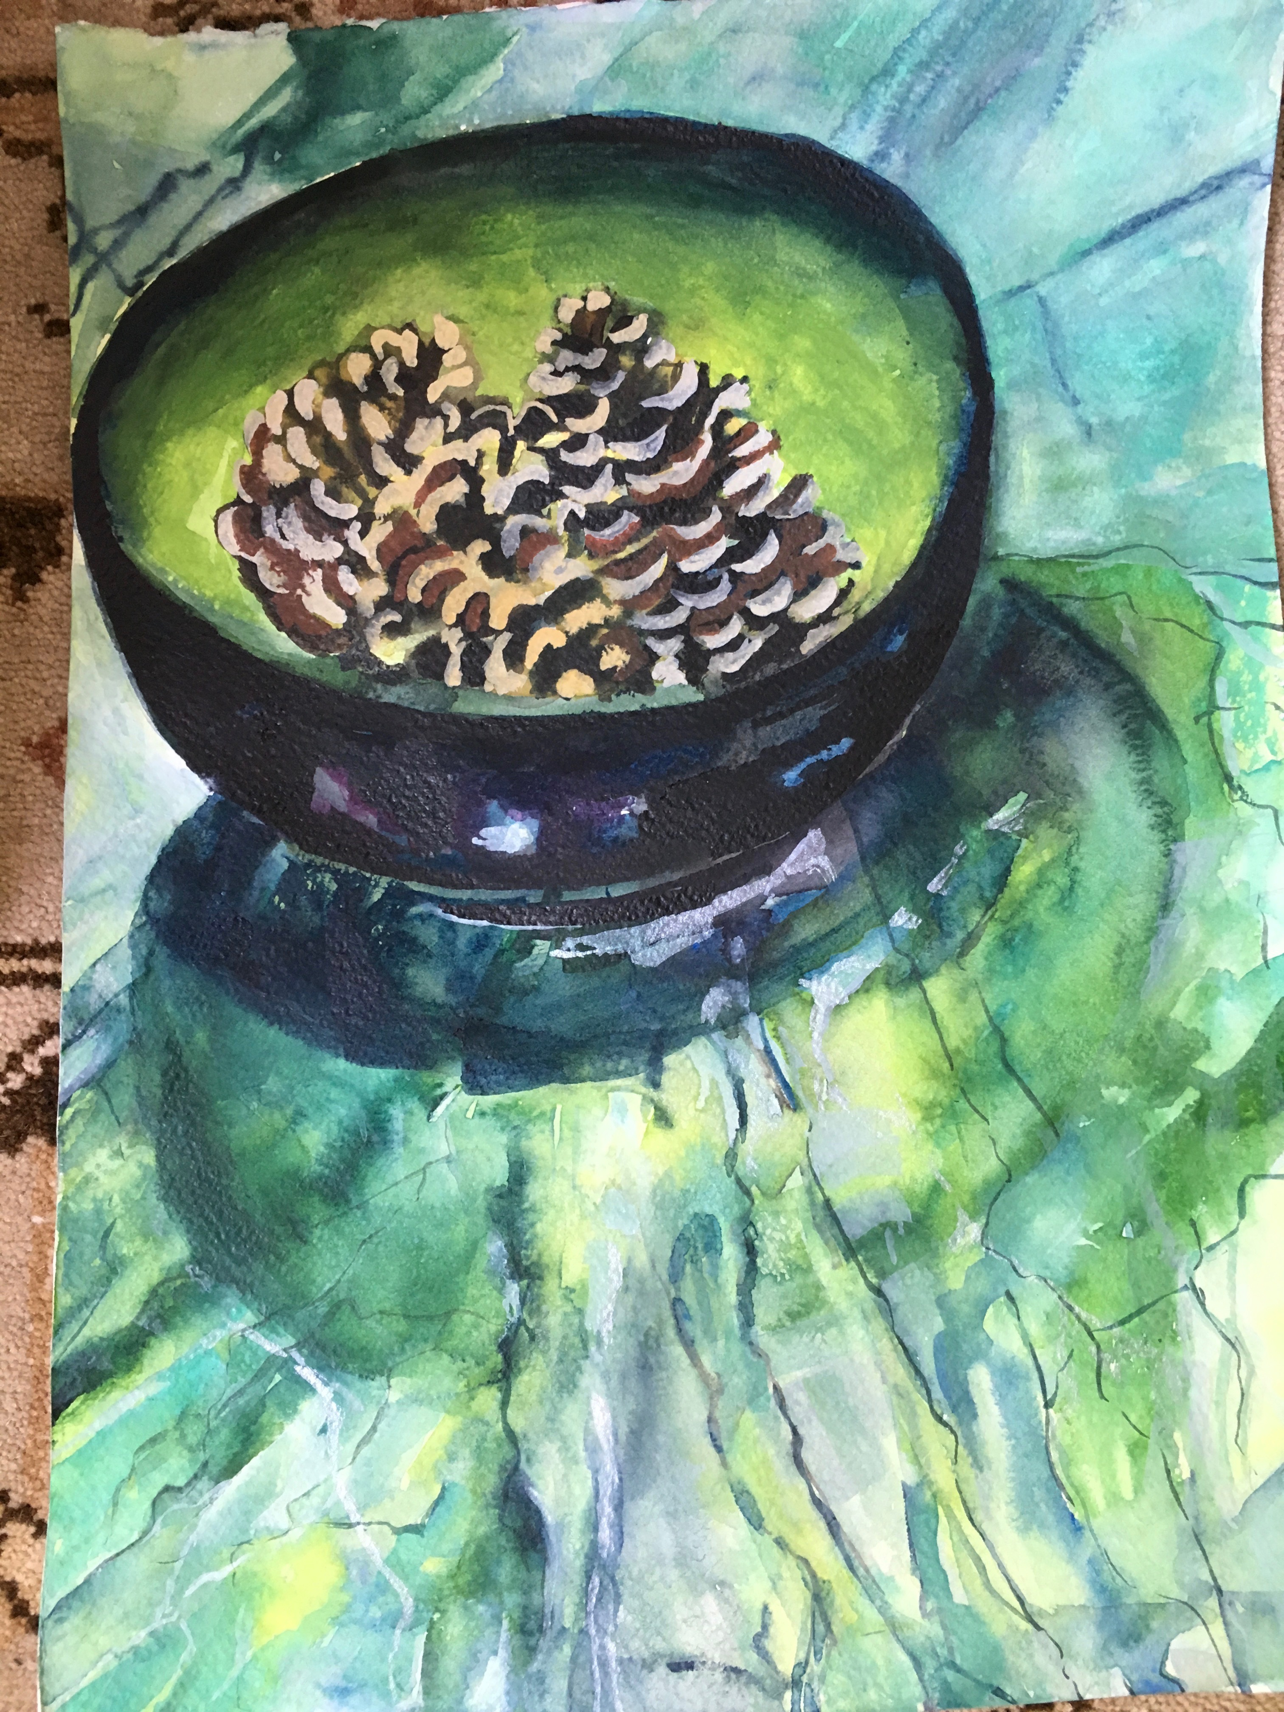
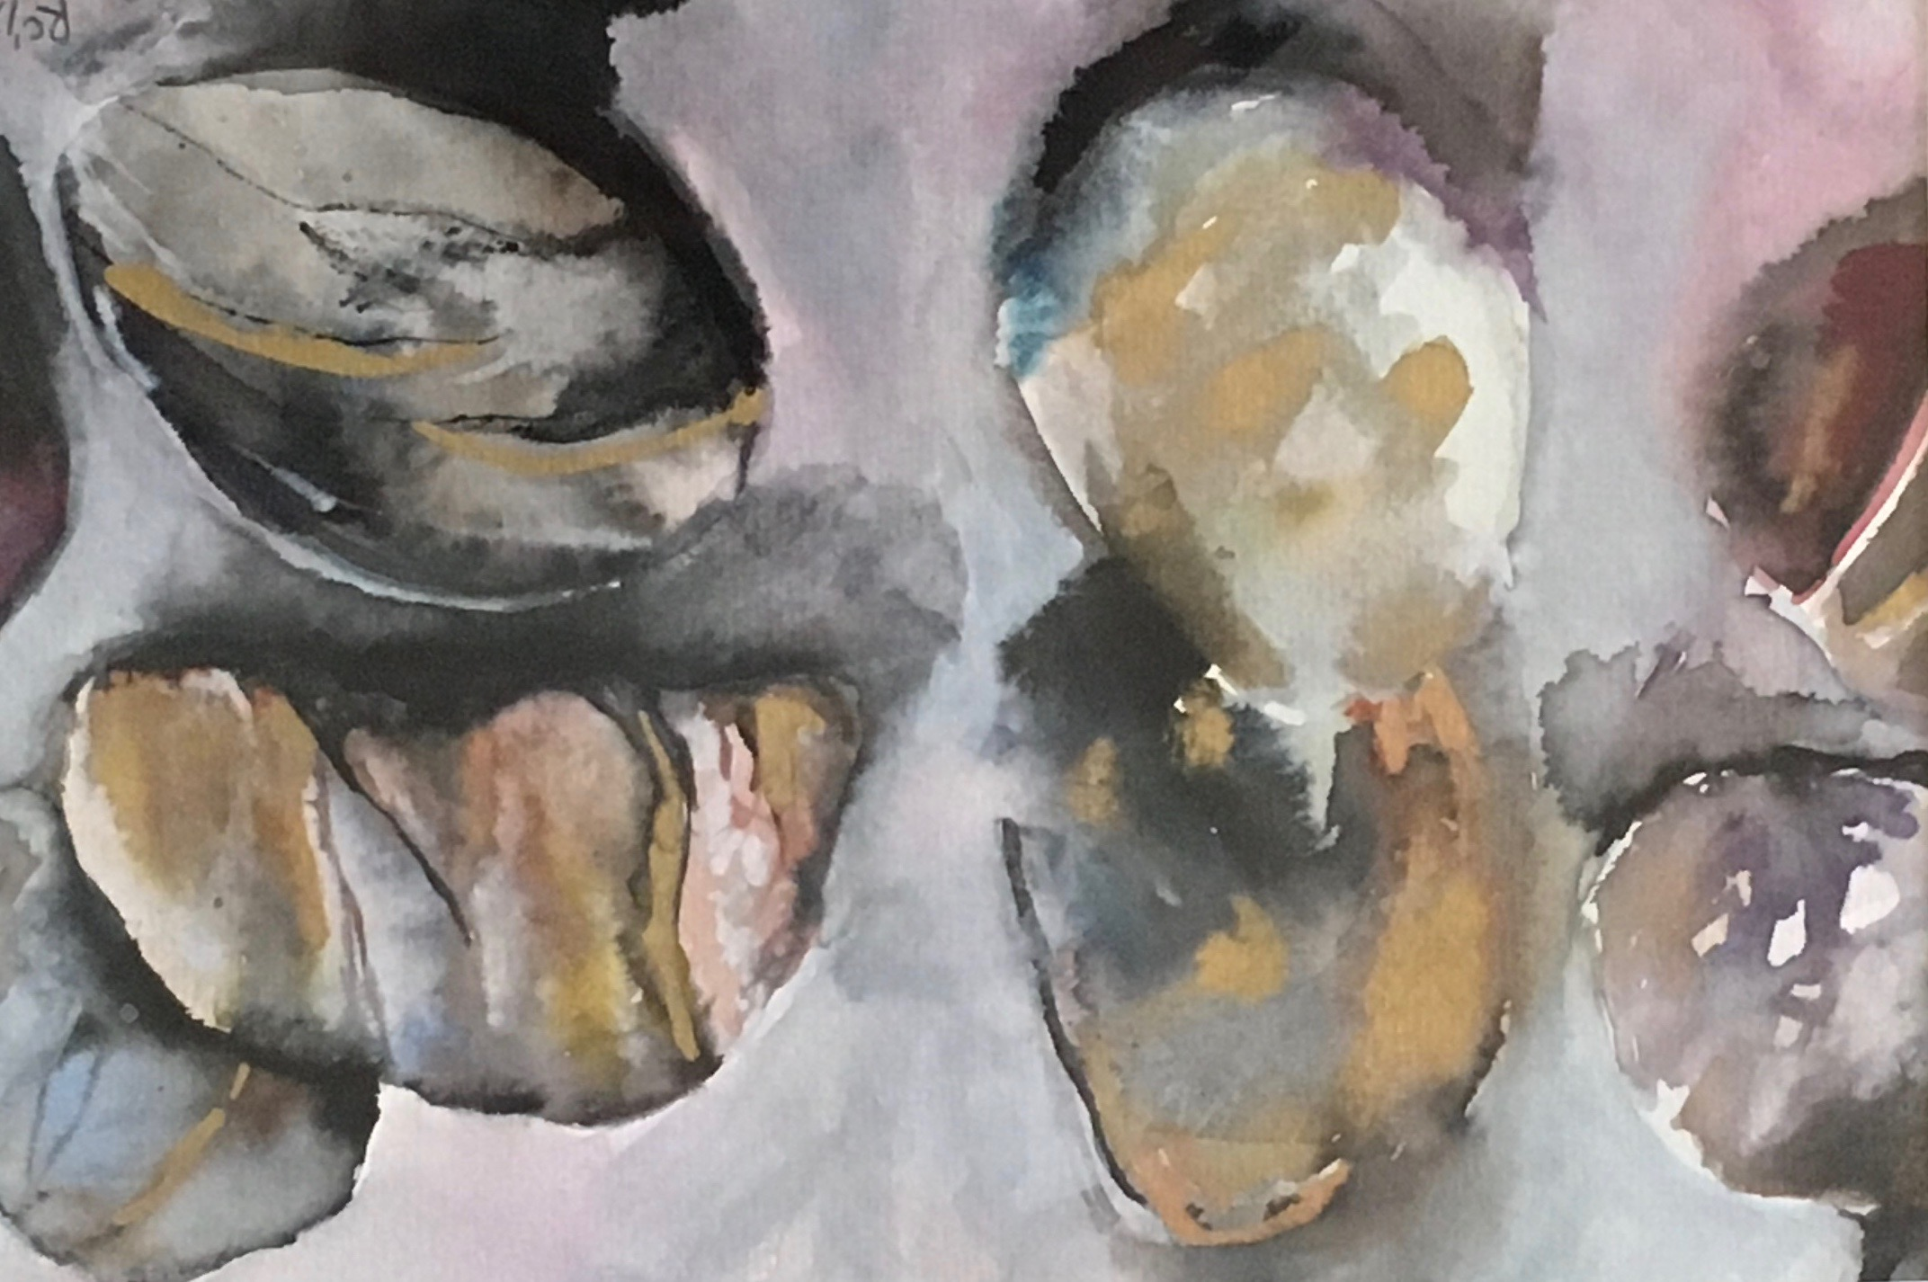
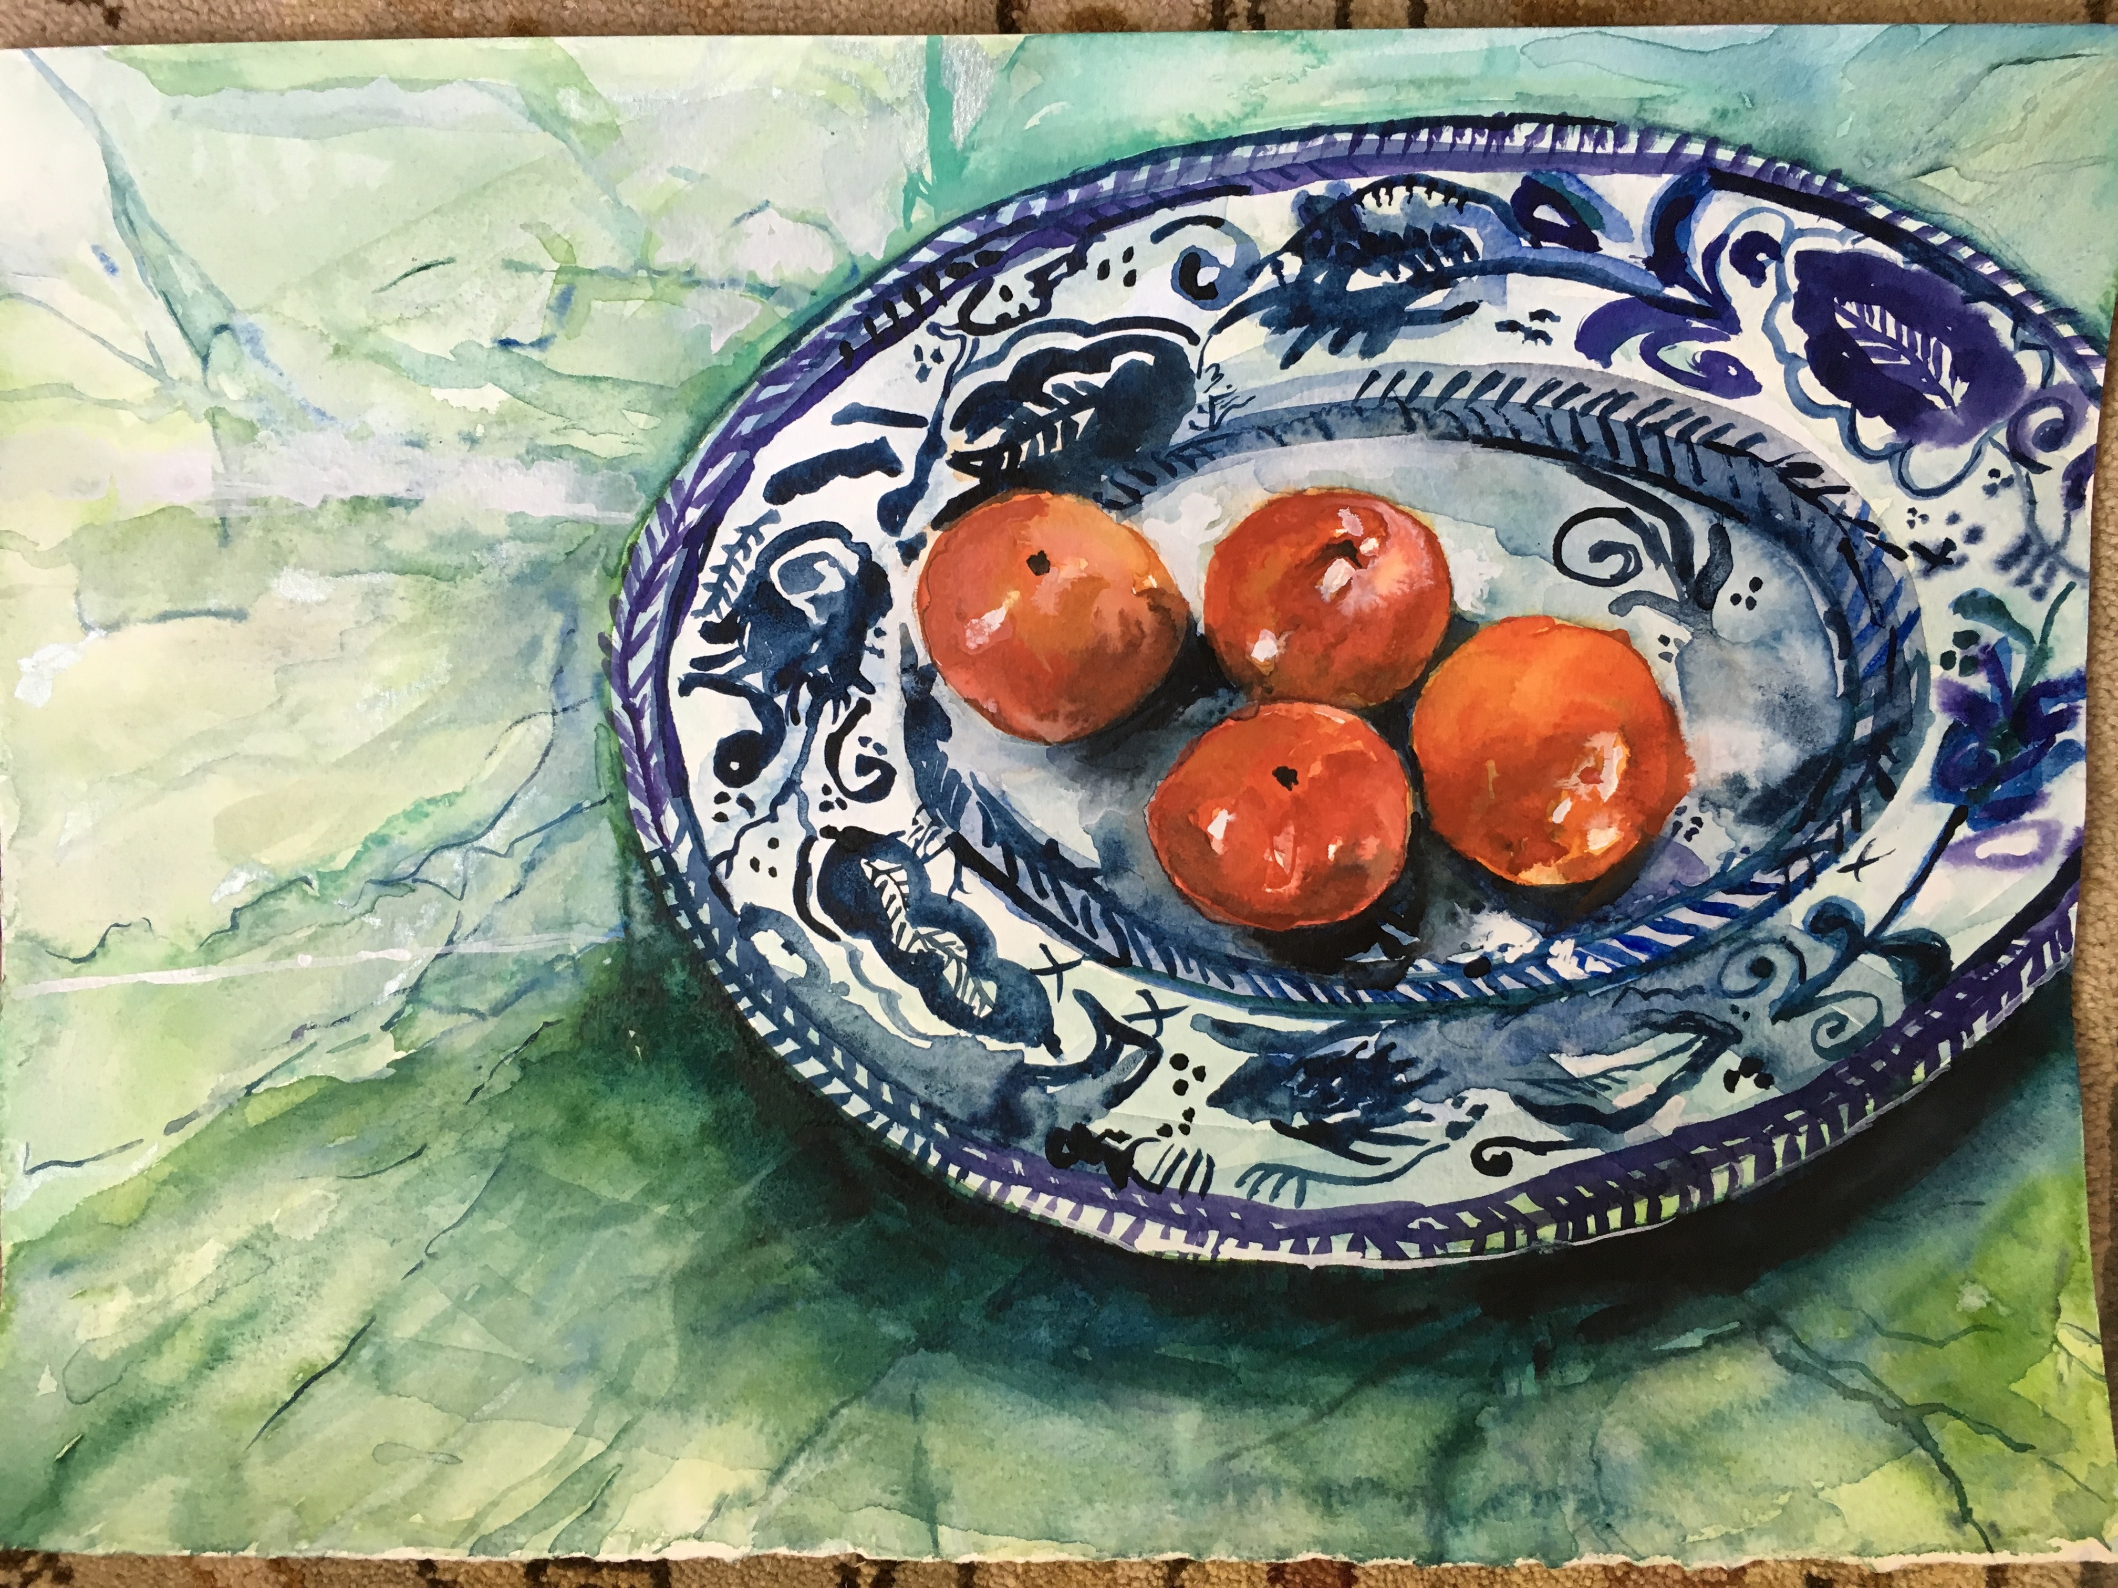
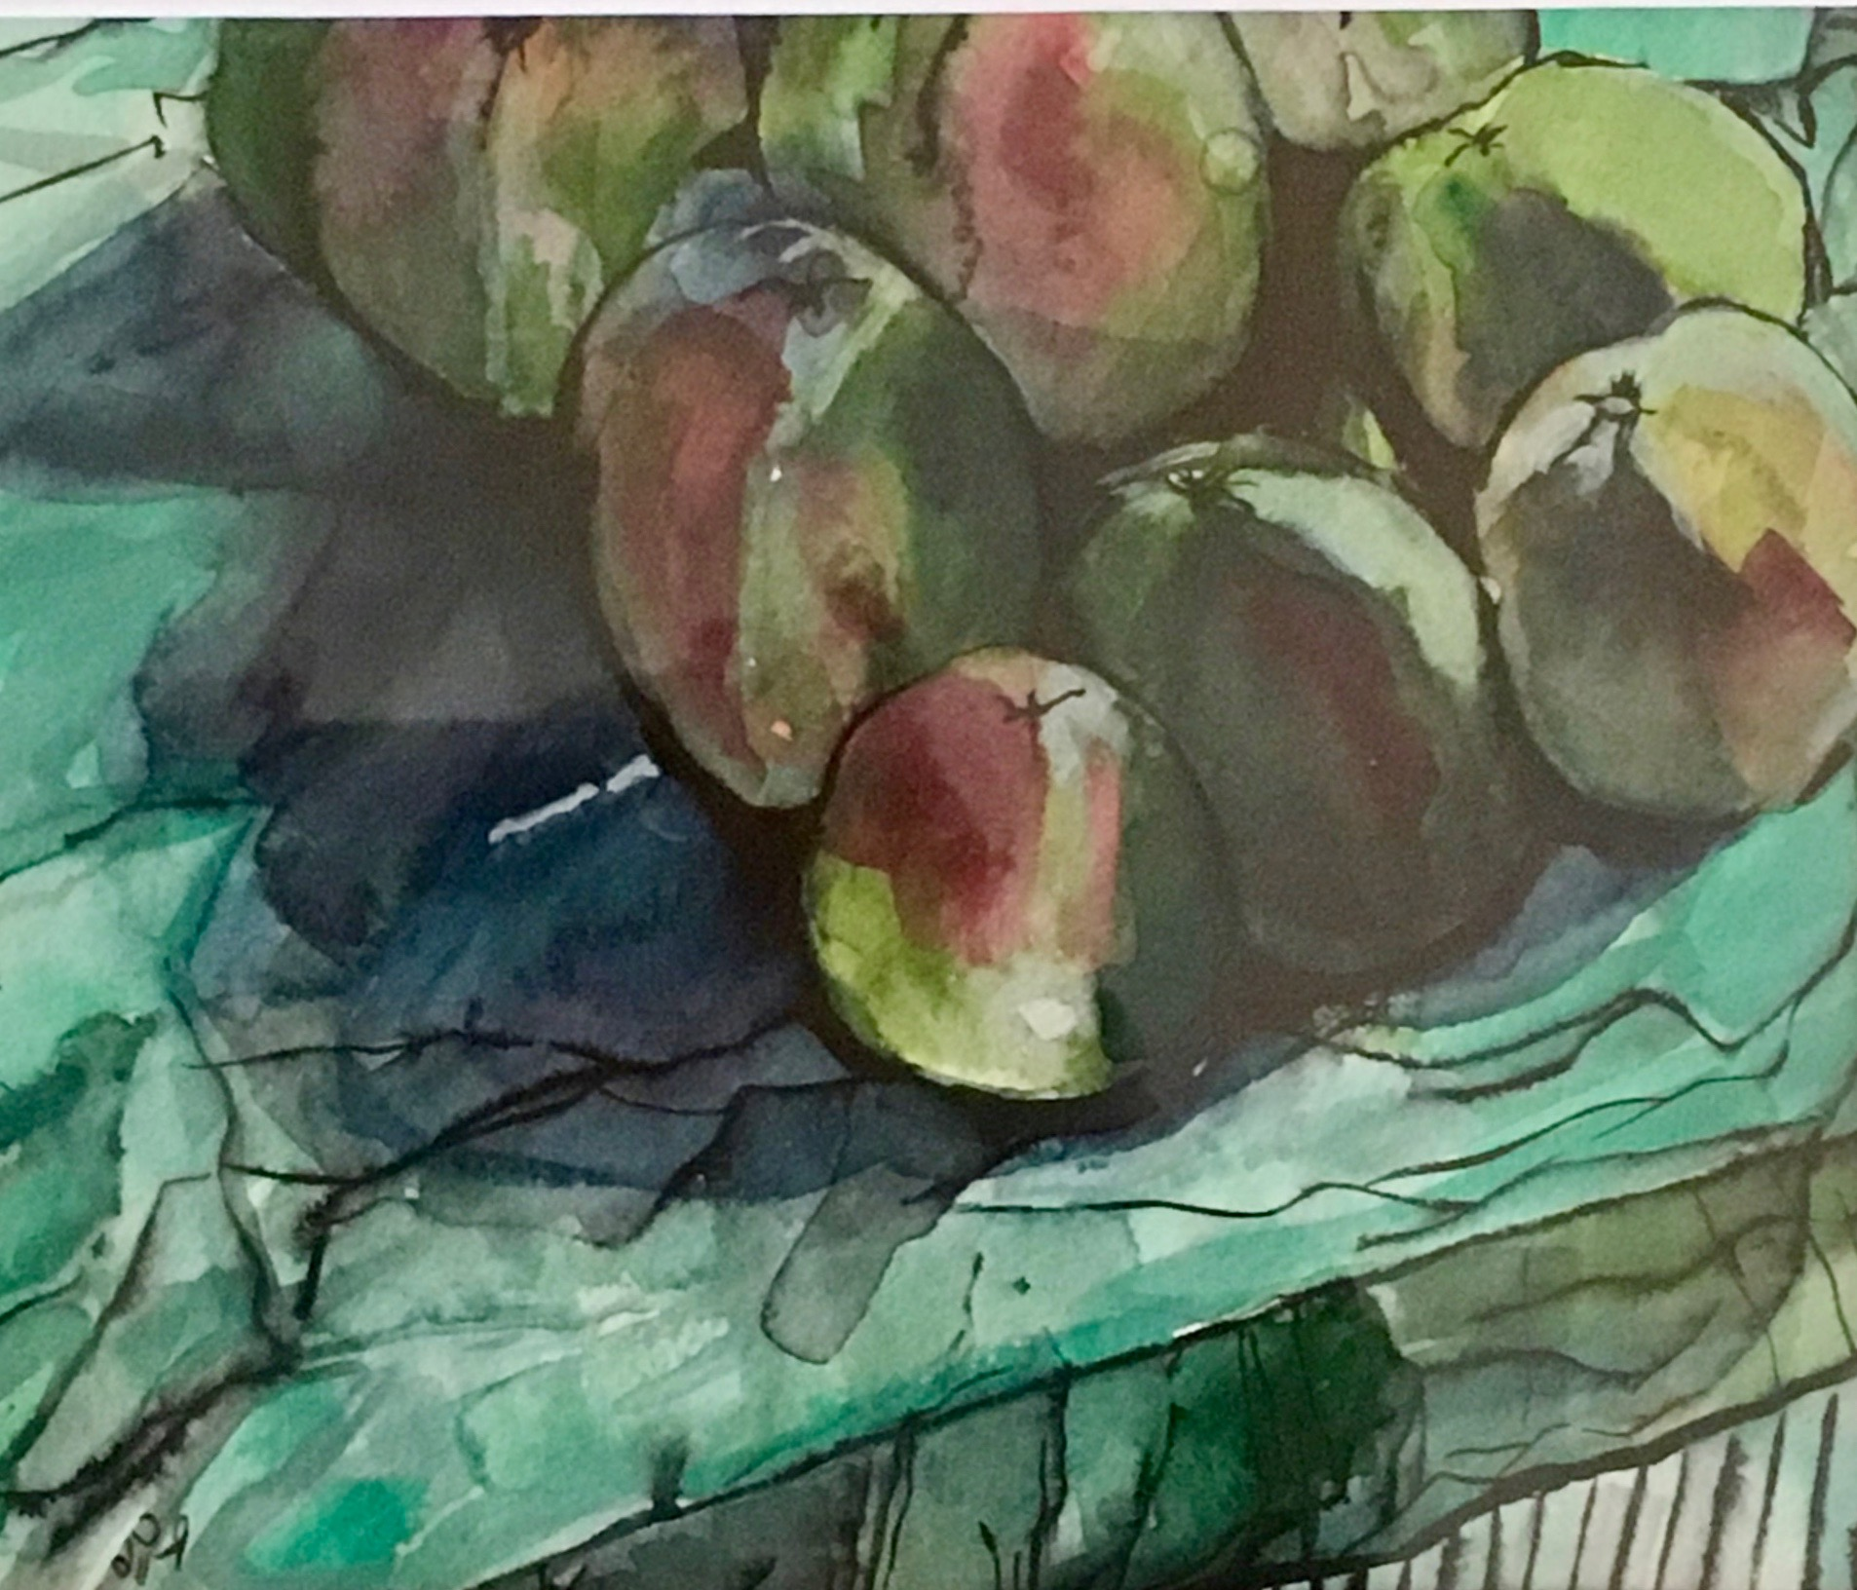
Dulwich Wood Group: Watercolour ‘Open Hut’
Here: Sunday August 12th !
Have a go at painting with Liz Butler from 11am
Work to View in Afternoon 2pm onwards

