Slide 1
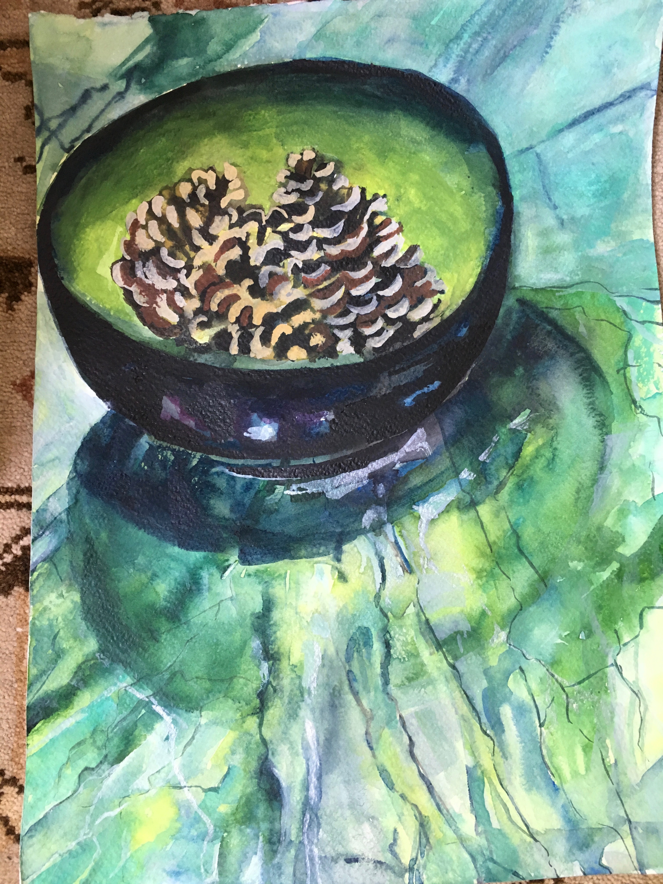
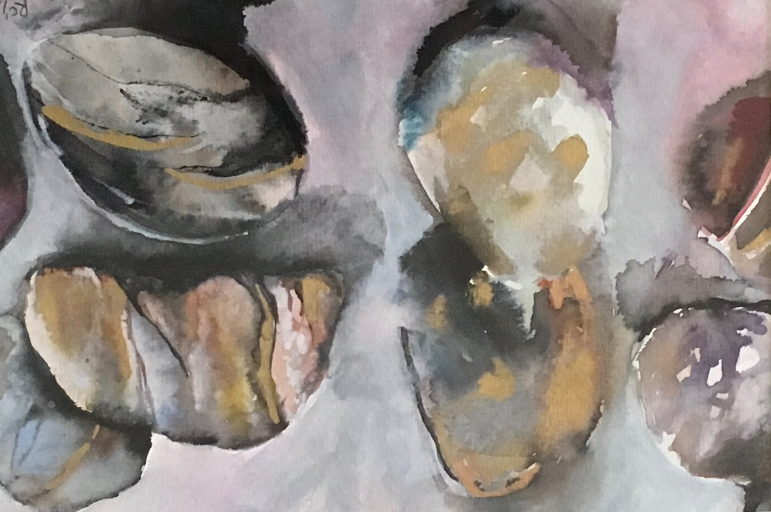
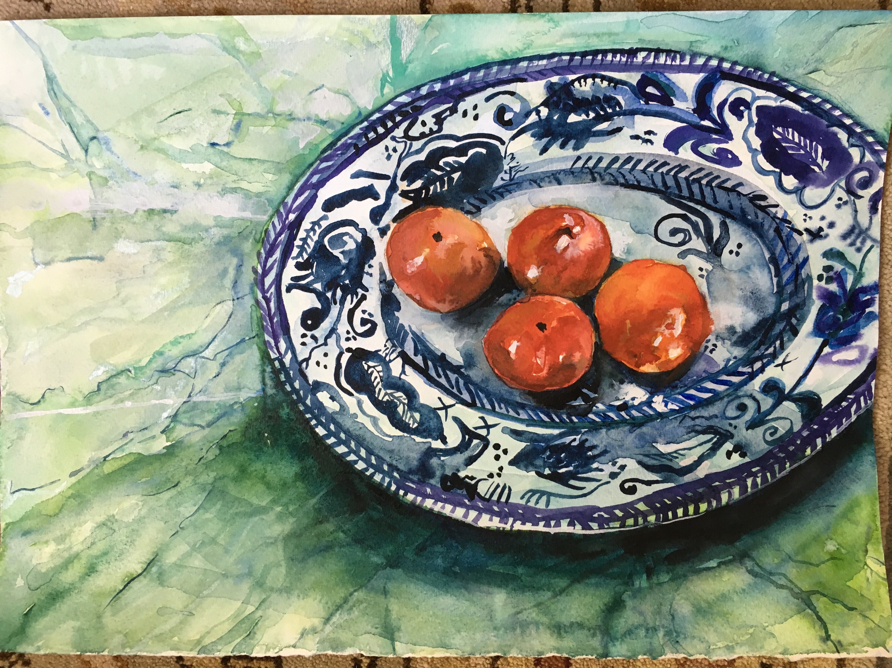
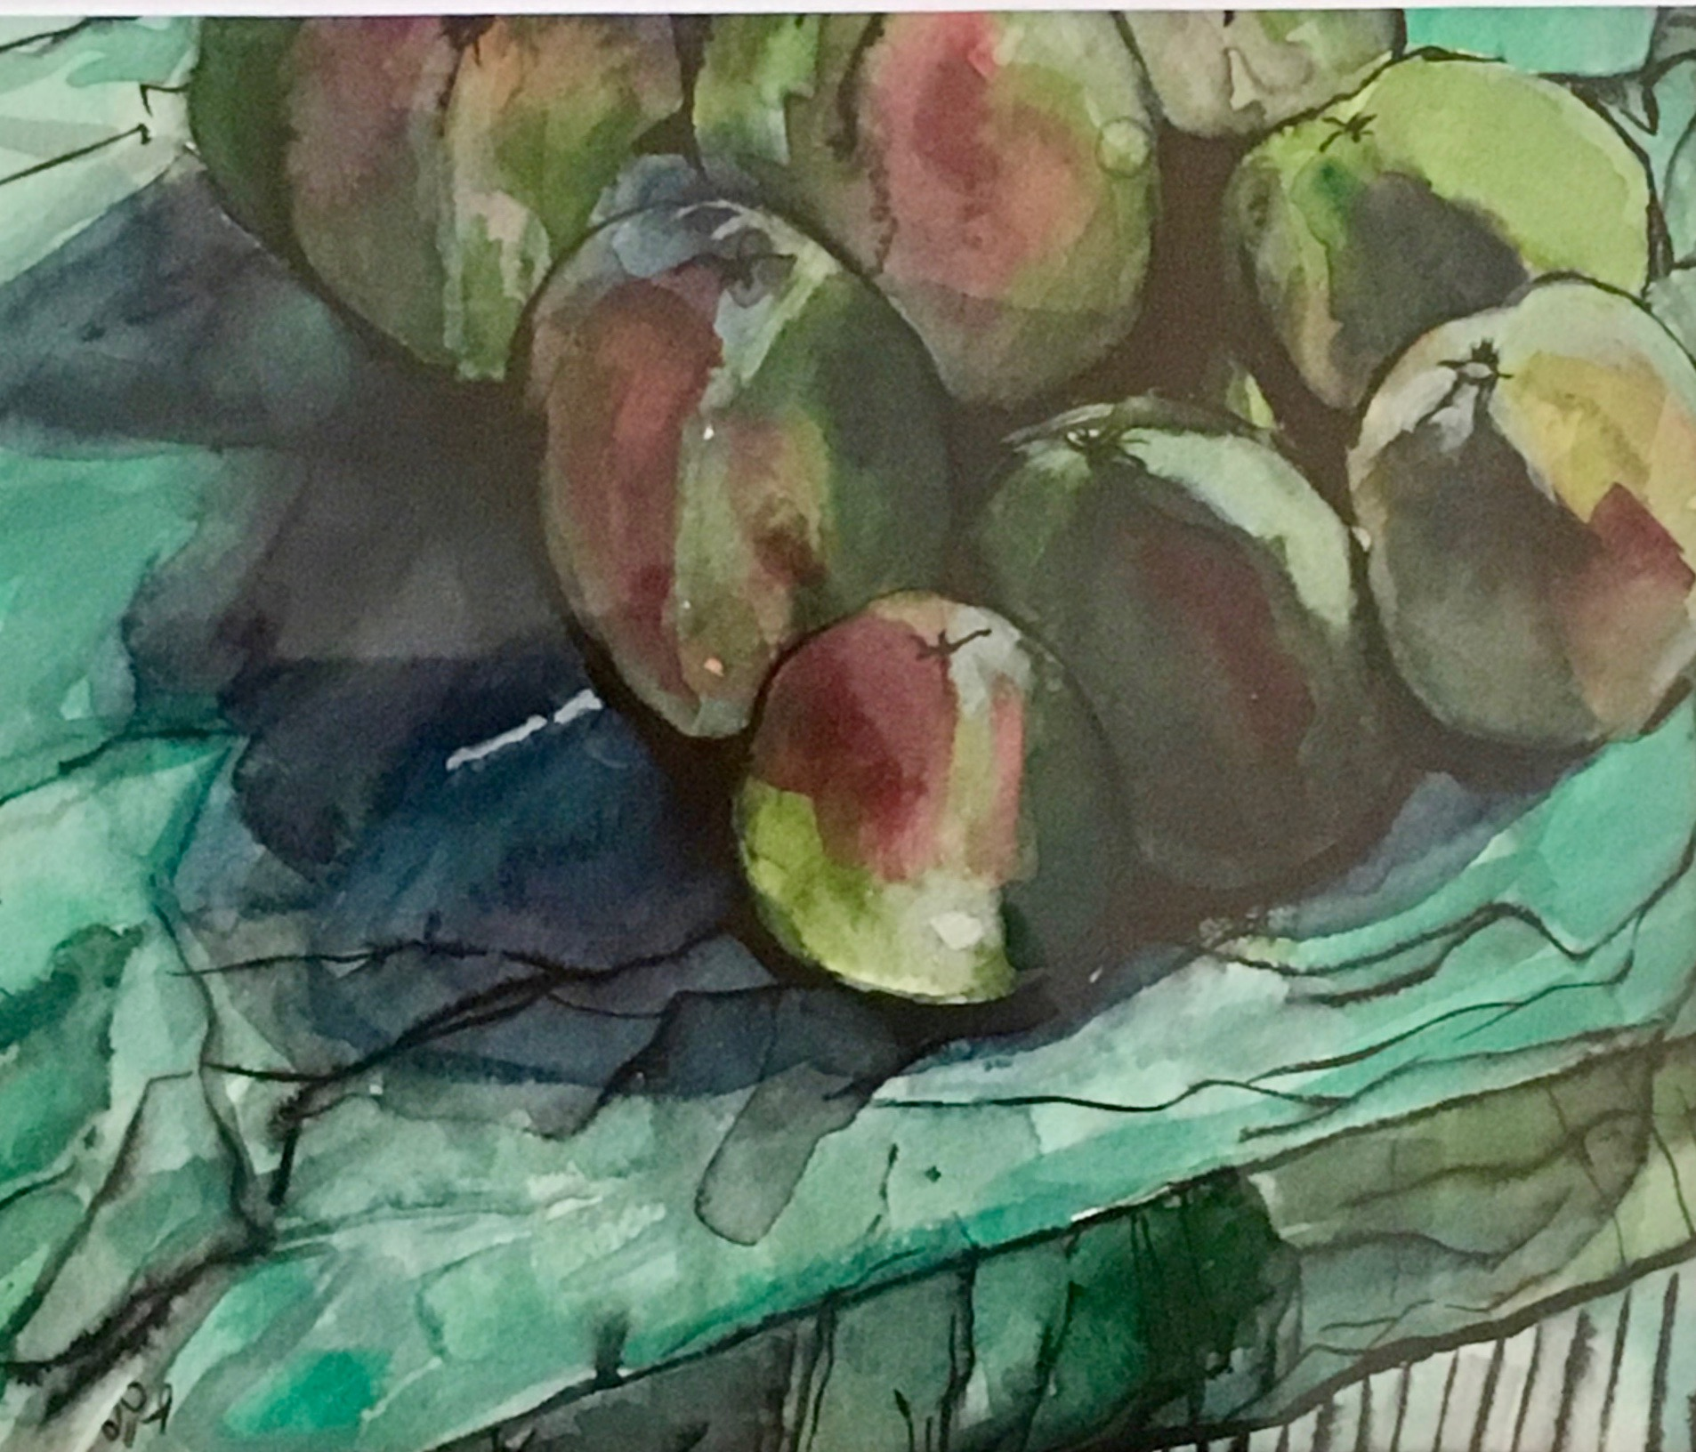
Dulwich Wood Group: Watercolour ‘Open Hut’ Here: Sunday August 12th ! Have a go at painting with Liz Butler from 11am Work to View in Afternoon 2pm onwards

